Slide 1

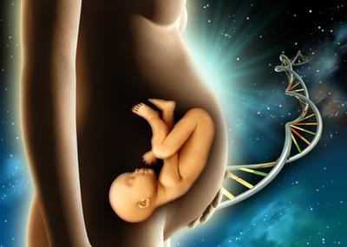
“ANATOMY THE BACKBONE OF MEDICAL SCIENCE.
Prof Oladapo A Ashiru OFR
MBBS, MS, PHD, HCLD/CC(ABB-USA), FASN, FNSEM.
18th Conference of the Anatomical Society of Nigeria- Feb 1st 2023

Slide 2
“Man know thyself,” and the healing power will be granted: How medical science helps to achieve the fruit of the womb.
Prof Oladapo A Ashiru OFR
MBBS, MS, PHD, HCLD/CC(ABB-USA), FASN, FNSEM.

Slide 3
OVERVIEW
INTRODUCTION
LANDMARK OF ART/IVF
INDICATIONS FOR PGD/PGS
STEPS LEADING TO PGD/PGS
BIOPSY TECHNIQUES
ADVANTAGES AND DISADVANTAGES
REVIEW OF RECENT DATA
SUMMARY/CONCLUSION
2

Slide 4
The Basic Sciences
ANATOMY
HAINES, MOHHUIDIN, LASI, CHAVAT
PHYSIOLOGY
DOSEKUN, OJO, ELEBUTE
BIOCHEMISTRY
OLAITAN, AKINRIMISI
NATIONAL ANATOMY
GRILLO, DESALU, OBOFUORIBO, ASHIRU, etc
2

Slide 5
EVOLUTION OF ANATOMICAL
KNOWLEDGE
GROSS ANATOMY
MICROSCOPIC
DEVELOPMENTAL
CELL BIOLOGY
MOLECULAR BIOLOGY
GENOMIC BIOLOGY
ARTIFICIAL INTELEGENCE
2

Slide 6
Today it is my pleasure to present our work on our ability to help
couples with infertility to have their babies,
those who are carriers of the sickle gene to have a healthy baby by the technique of Pre-Implantation Genetic diagnosis (PGD)
and those with various types of toxins standing in their way of conception have their bundles of joy.

Slide 7

The genesis of the above presentation started at the College of Medicine through excellent teaching by highly qualified and experienced teachers, and stimulating classmates
2

Slide 8
These teachers taught us with extreme devotion, dedication, dignity, discipline and they exhibited nobility, even in the classroom; particularly hose pioneer teachers.
Notes:
I trained in the College, became a lecturer, Professor, started Postgraduate medical training in Anatomy in CMUL, brought in the first set of Sprague-Dawley albino rats for research throughout the College, and facilitated the elevation of many to Professorship level at CMUL, National and International places.

Slide 9
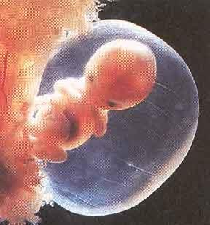

ASSISTED REPRODUCTIVE TECHNOLOGY (ART)
◆ Conception requiring the complex handling or manipulation of male and female gametes in-vitro to facilitate pregnancy
◆ HCLD (High Complexity Laboratory Director-ABB-USA)

Slide 10


Landmarks in ART- Basic Science
1969 Capacitation Chang & Yamagimachi
1977 LHRH-Hypothalamus
1978 FSH +ve Pituitary
Schally & Guileman Ashiru & Blake

Slide 11
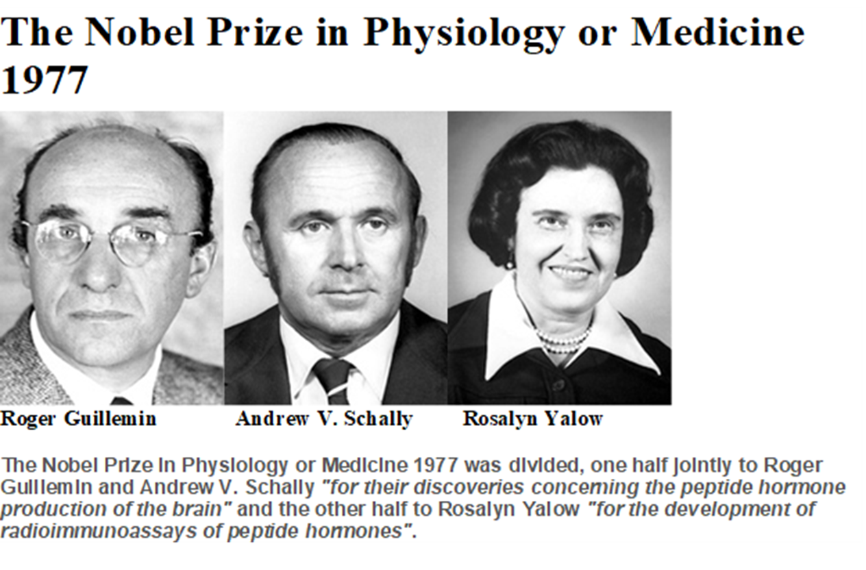

Slide 12
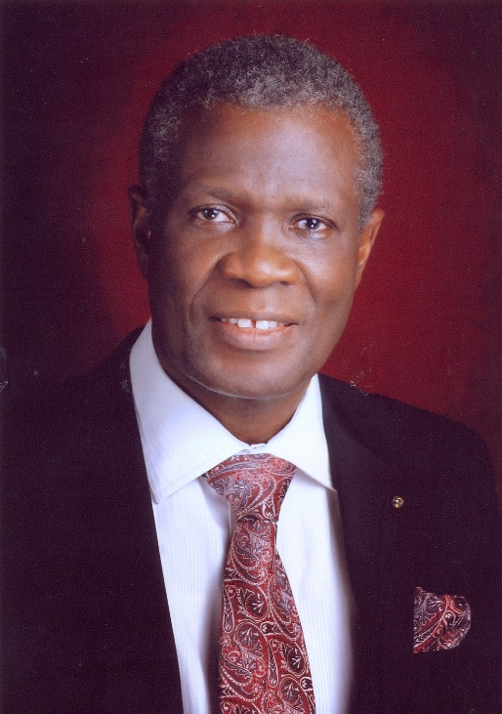
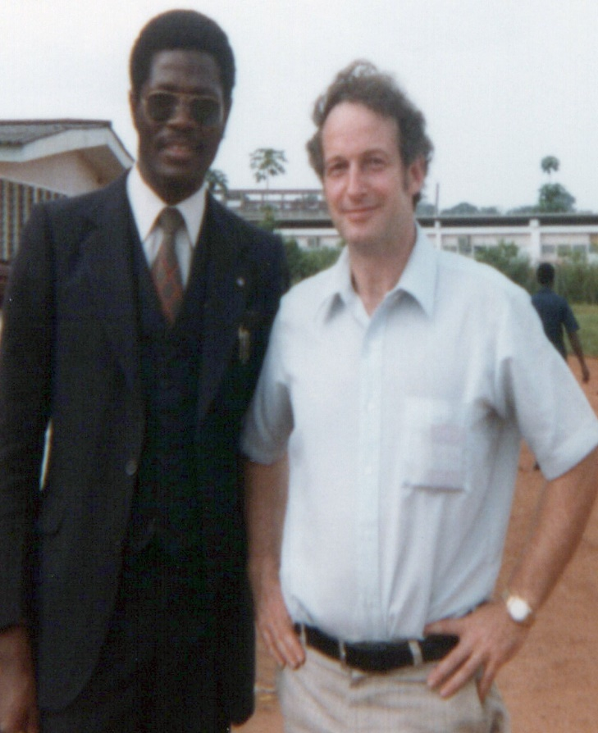
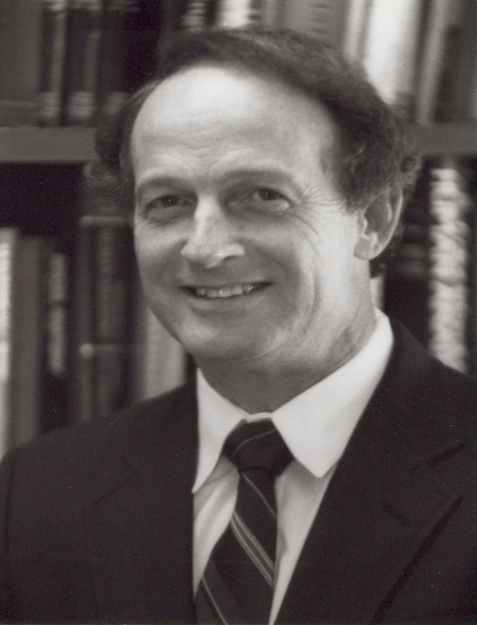
The FSH Positive Feedback
The basis of the use of Pergonal, Folligraph
Folliculin, GONAF and other gonadotropins to get multiple follicular development and eggs.
Endocrinology 105:1162-1167, 1979

Slide 13
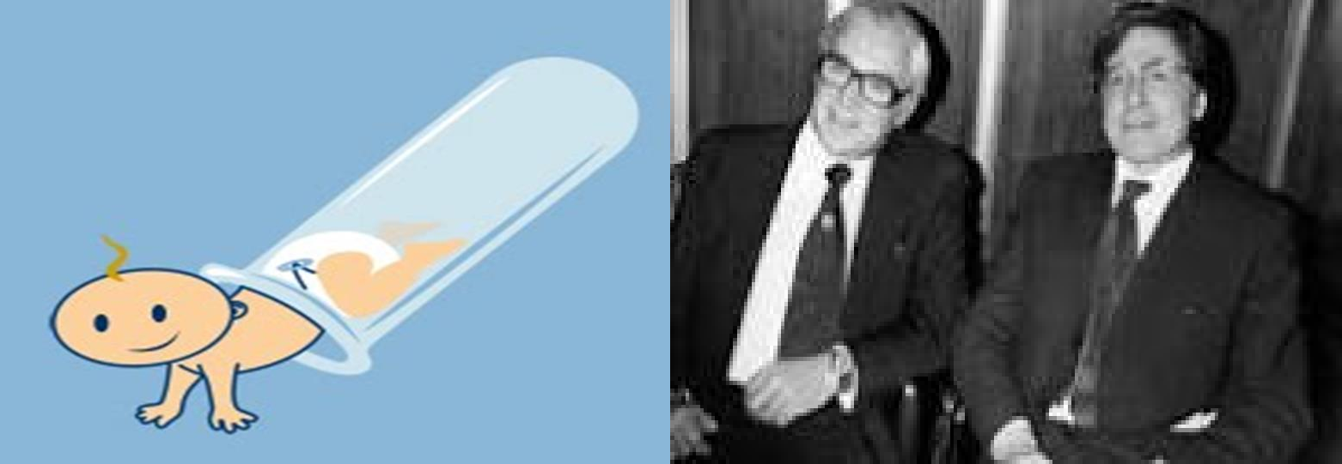
LANDMARKS IN ART (Test tube Baby)
◆ 1976 IVF in London
◆ 1978 IVF baby London
Steptoe & Edwards
Steptoe & Edwards (First IVF Baby – Louise Brown)
◆ 2010 Noble Prize in Medicine given to Robert Edwards.

Slide 14
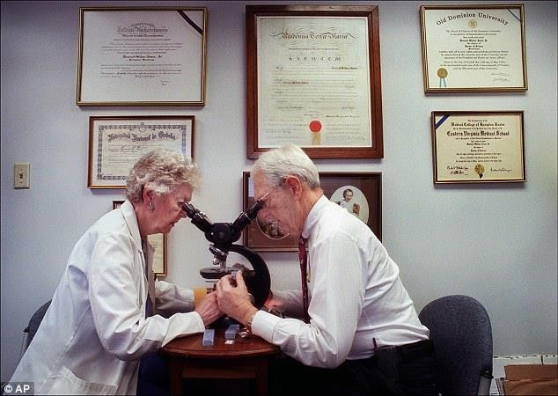
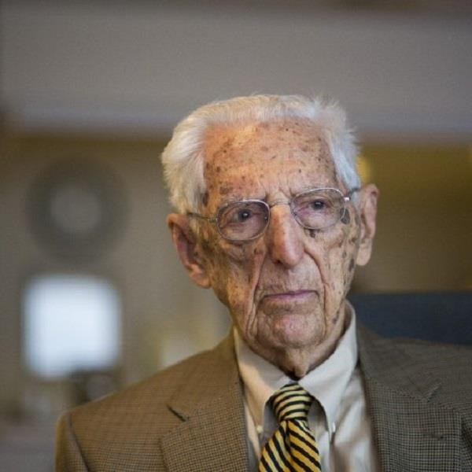
LANDMARKS IN ART
◆ 1980 IVF in Melbourne, Australia Carl Wood et al
◆ 1982 IVF in Virginia, Howard & Georgeanna Jones

Slide 15
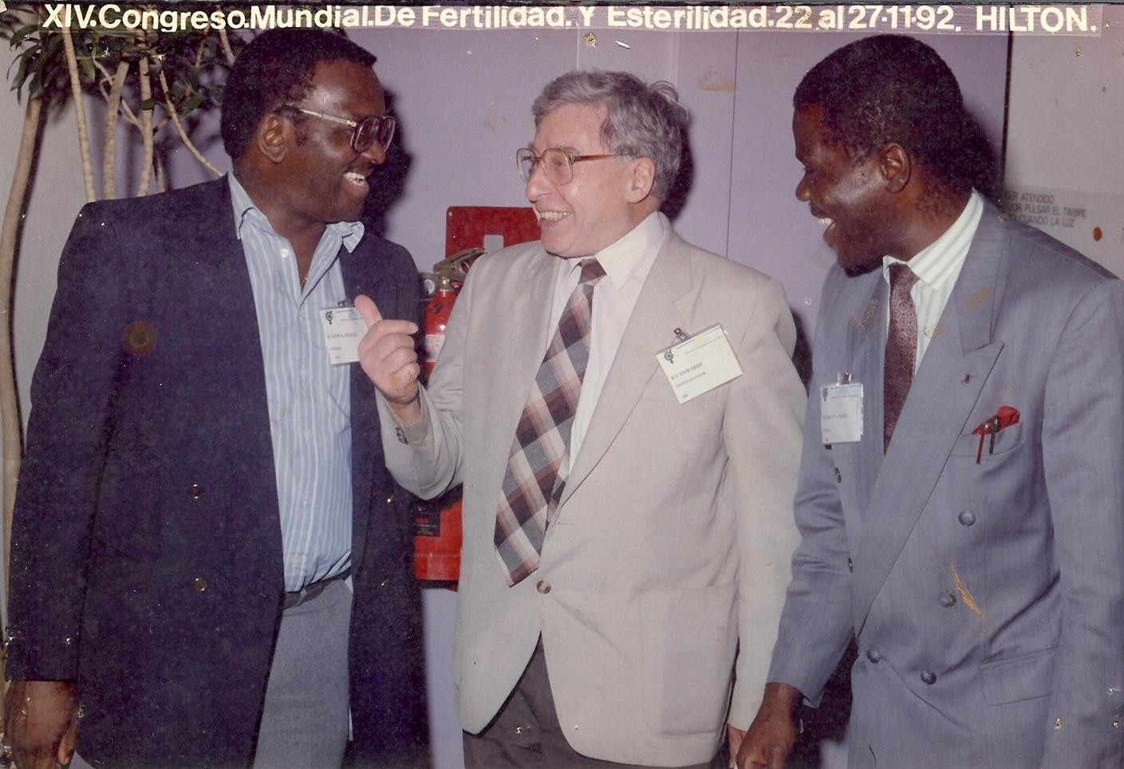
LANDMARKS IN ART
◆ 1984 IVF in Lagos, Nigeria, Ashiru & Giwa-Osagie
1986/1989 (First Baby Olusola)

Slide 16

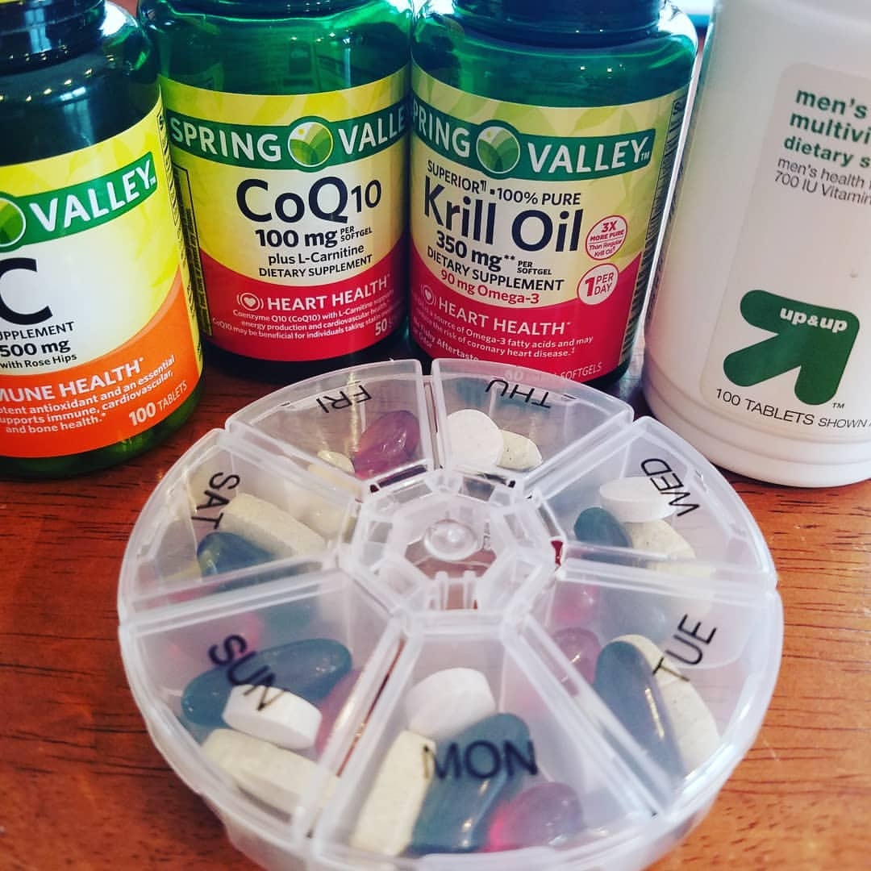
Ovarian Improvement Vitamins

Slide 17
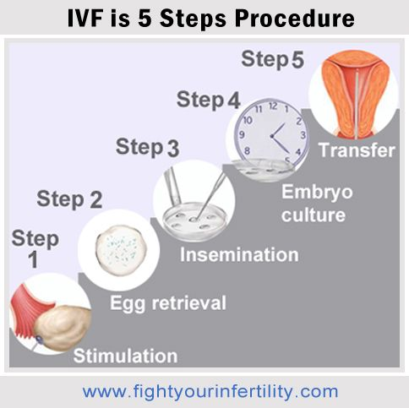
IVF STEPS

Slide 18
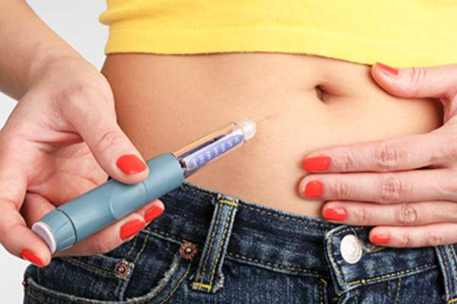
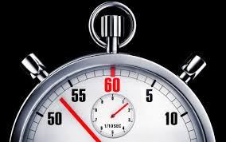
TIMED SUBCUTANEOUS INJECTIONS

Slide 19
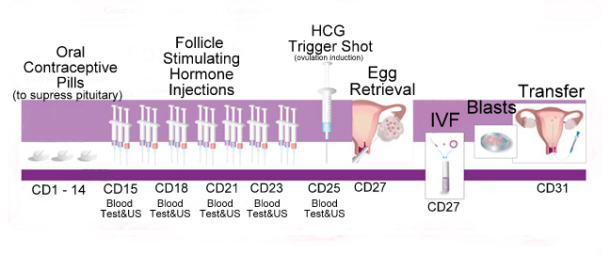
PILLS WITH DAILY INJECTIONS

Slide 20
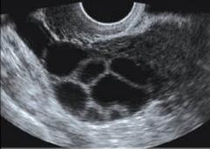
Stimulated Ovary

Slide 21
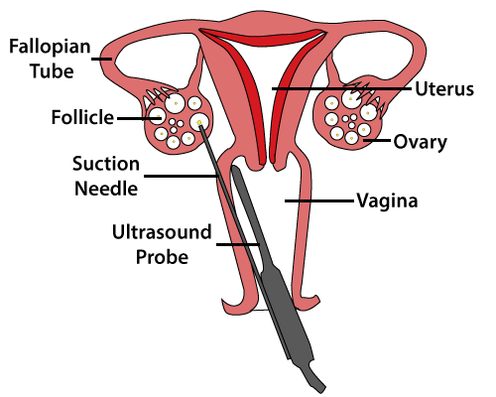
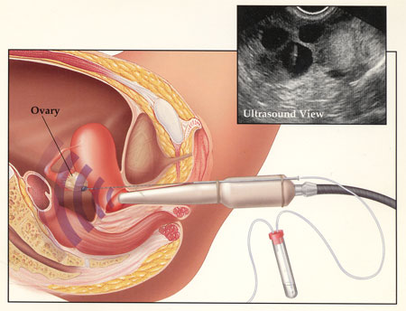
Egg Retrieval/Pick Up.

Slide 22
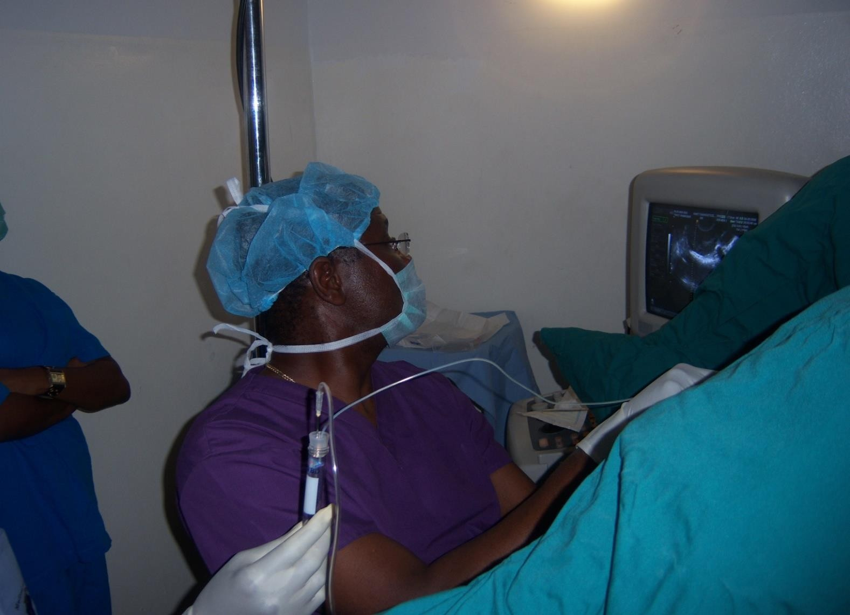


ULTRASOUND-GUIDED OOCYTE ASPIRATION

Slide 23
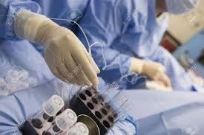
STRICT TEMPERATURE CONTROL

Slide 24
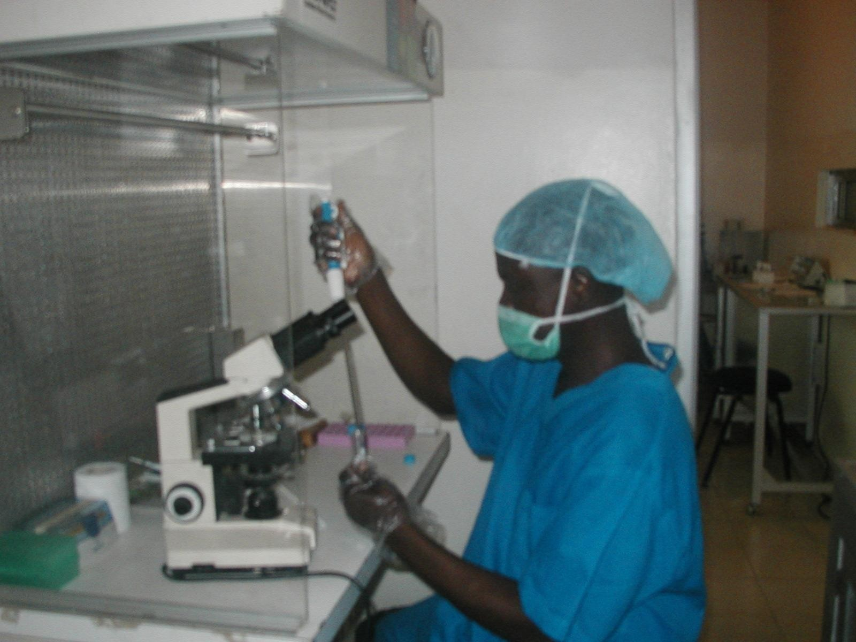
IVF Sperm processing
SPERM CAPACITATION
8/9/2017 MART, UIC 4971970 www.medicalartcenter.com

Slide 25
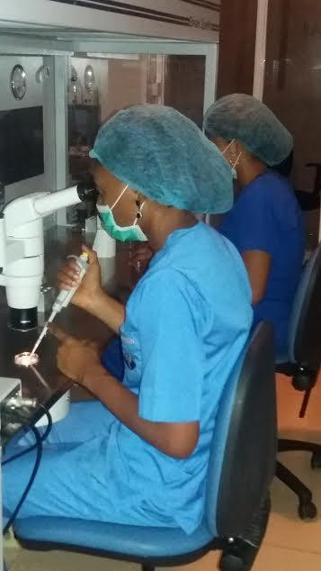
IN-VITRO FERTILIZATION
MART, UIC
4971970 _{8/9/}
www.medical
artcenter.com
2017

Slide 26
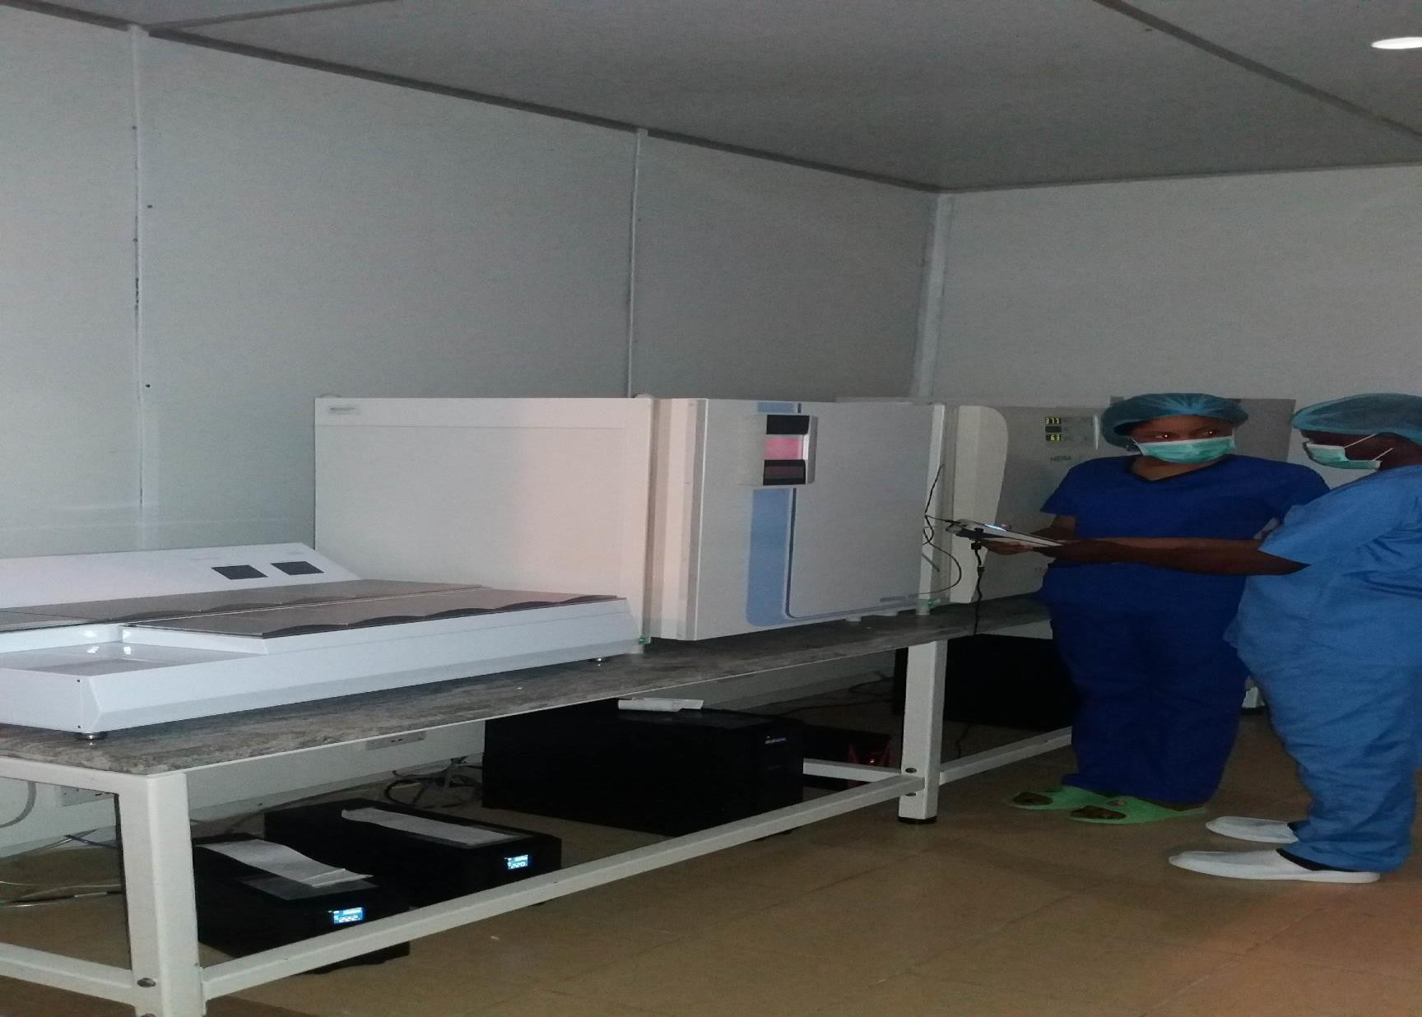
IN-VITRO FERTILIZATION
MART, UIC
4971970
www.medical
artcenter.com
8/9/2017

Slide 27
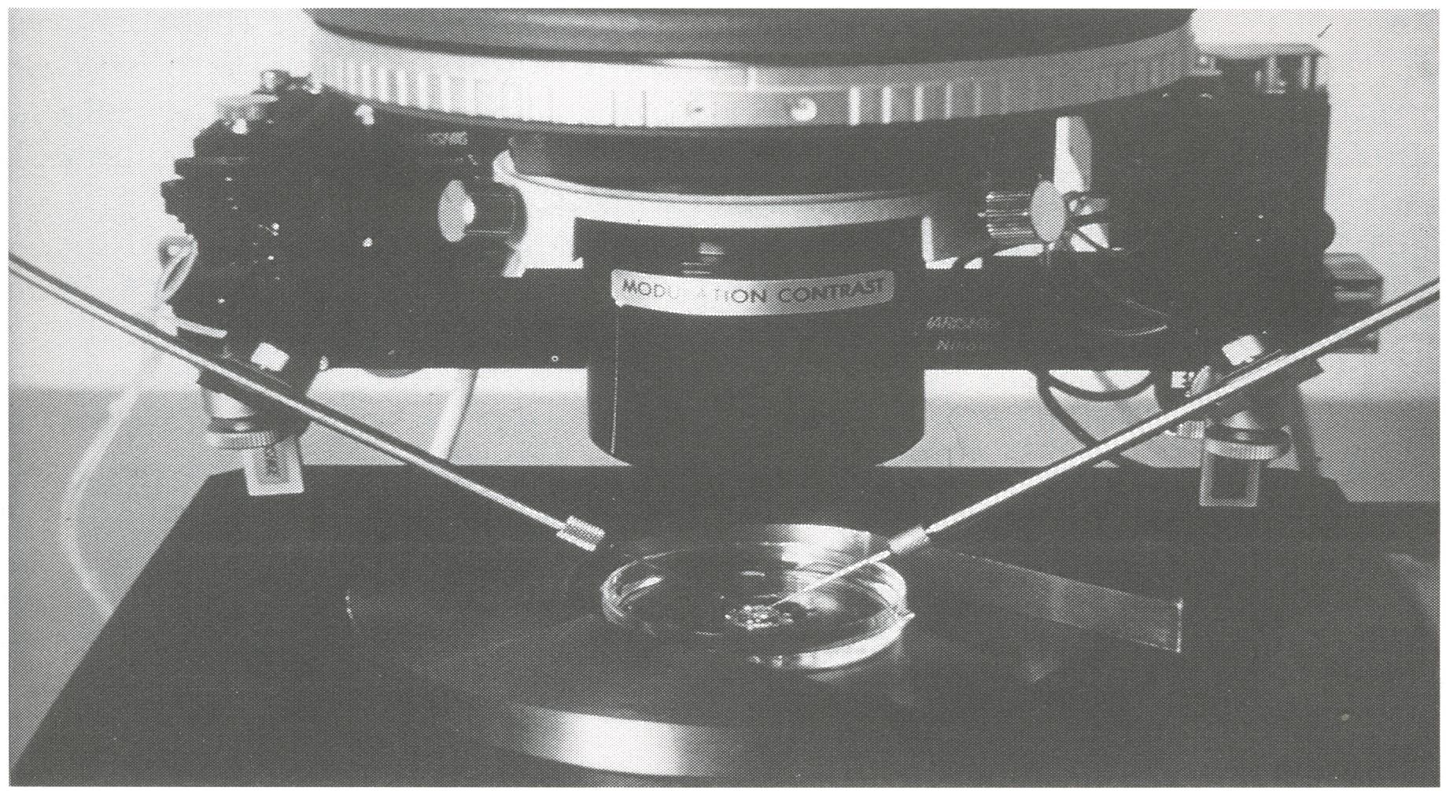
Assisted Fertilization Micromanipulation ICSI
MART, UIC
4971970
www.medical
artcenter.com
8/9/2017

Slide 28
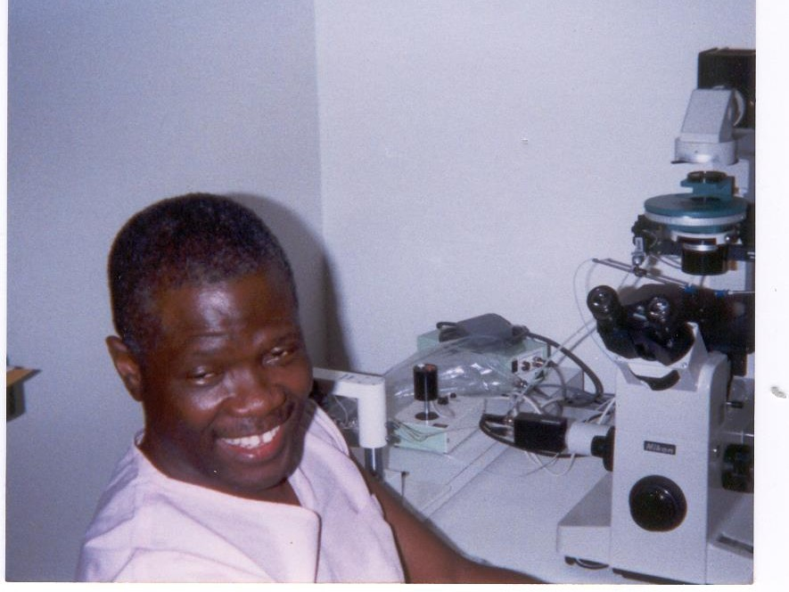
Intra Cytoplasmic Sperm Injection- UIC 1995
8/9/2017
MAR
www.medi
T, UIC 4971970
calartcenter.com

Slide 29
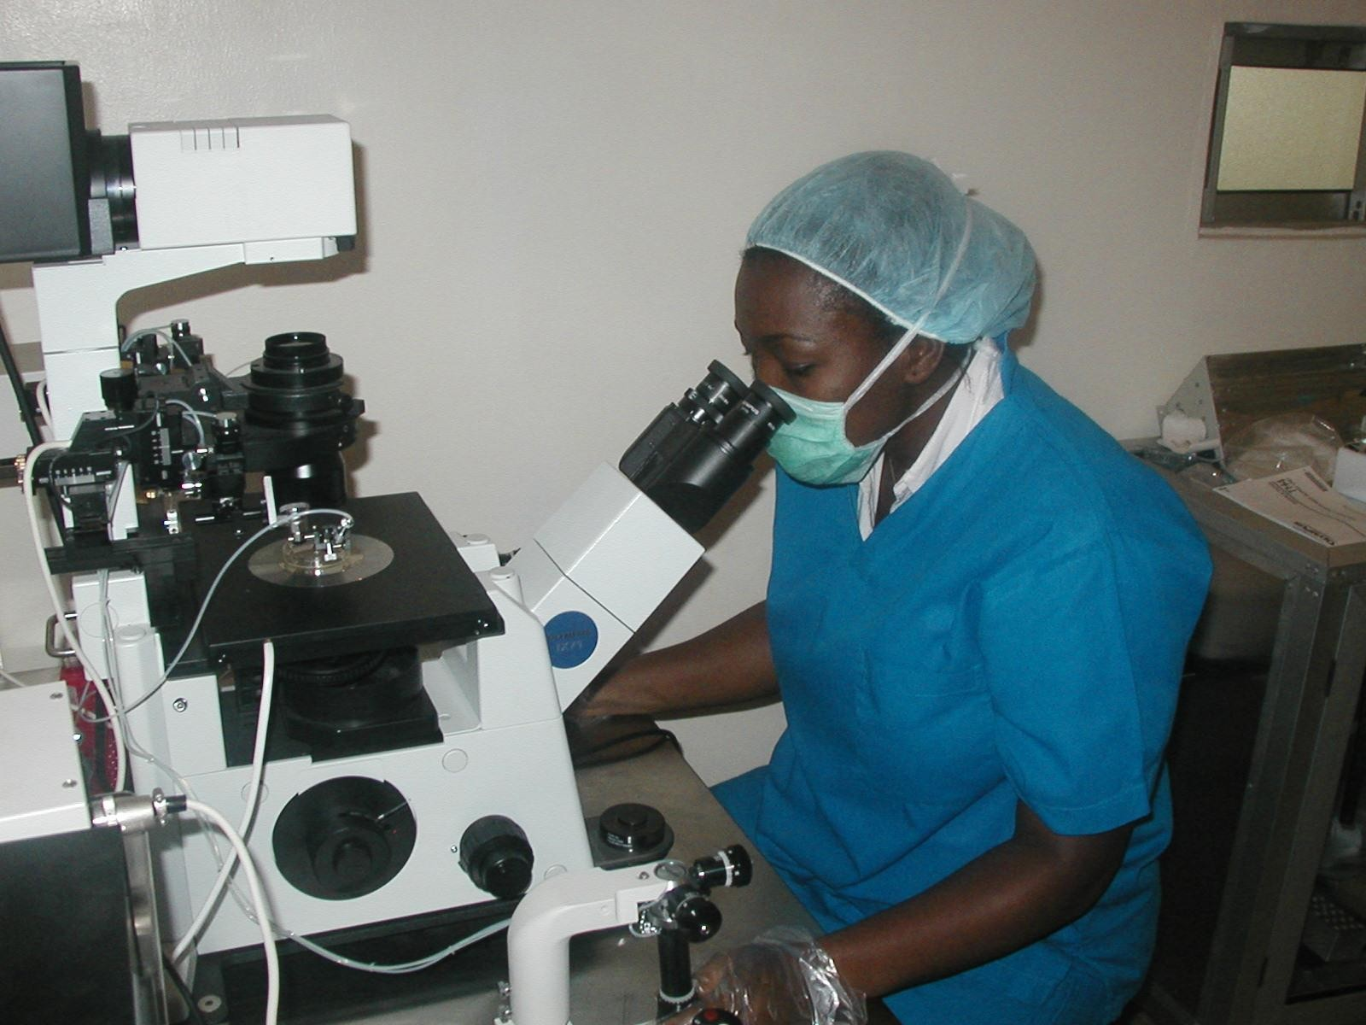
MART, UIC 4971970 ^{8/9/2}
www.medicalartcenter.com
017

Slide 30
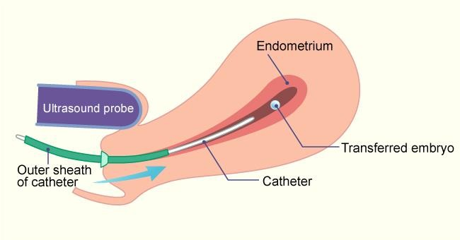
Ultrasound-guided Embryo transfer (UGET)

Slide 31
DEVELOPMENT OF ART GAVE OPPORTUNITY FOR PGD: WHAT IS PGD?
◆ Pre-implantation Genetic Diagnosis (PGD)
◆ Targeted genetic testing of known genetic abnormality in the couple:
◆ Single gene disorder
◆ Structural chromosomal abnormality

Slide 32
LANDMARKS IN PGD
◆ Jacobson CB & Barter RH 1960 - 1st prenatal diagnosis
◆ Saiki et al 1985 – PCR
◆ Alan Handyside and Robert Winston 1989– Embryo Biopsy
◆ Verlinsky Y et al 1999 – Polar body testing

Slide 33
LANDMARKS IN PGD
◆ 1990: Sexing Human Preimplantation Embryo, & Polar Body Analysis for Mendelian Disease; - 1st PGD Baby Born (Alan group)
◆ 1993: FISH Analysis for Sexing and for PGD of Aneuploidies
◆ 1996: PGD for Chromosomal Translocations
◆ 1999: PGD for Late Onset Common Disorders with Genetic Predisposition

Slide 34
LANDMARKS IN PGD
◆ 2000: Pre-implantation human leukocyte antigen (HLA) Typing
◆ 2002: 1st Thousand PGD Babies Born
◆ 2002 onwards: Many technological developments CGH, aCGH, NGS
◆ 2010: PGT for FB & CA in Nigeria

Slide 35
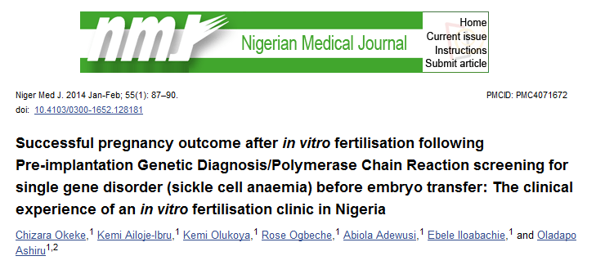
FIRST SUCCESSFUL PGD PREGNANCY AND LIVEBIRTH IN NIGERIA- 2013
Known PCOS, had an affected 2yr old.
Achieved pregnancy in 2012 in FET cycle.
1st Healthy sickle cell free baby boy after PGD
22

Slide 36
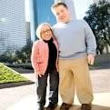
Autosomal dominant disorders:
INDICATIONS FOR PGD
One of the couple is a carrier of the genetic defect (e.g., Huntington Disease or dwarfism)
Autosomal recessive disorders:
Both couple are carriers of the genetic defect (e.g., Sickle Cell Disease)

Slide 37
INDICATIONS FOR PGD
◆ X-linked disorder:
◆ One of the couple is a carrier of a x-linked genetic defect (e.g., Hemophilia)
◆ Human leukocyte antigen (HLA) matching
◆ Structural chromosomal abnormality:
◆ One of the couple is a carrier of a chromosome abnormality (translocation, inversion, deletion, insertion)

Slide 38
PRELIMINARY PROCESSES FOR PGD (SICKLE CELL ANEMIA)
◆ DNA test probe must developed on a per couple basis.
◆ Buccal swabs are obtained from couple and direct family members.
◆ At least two (2) buccal swabs each from both families.
◆ One family member (on each side) must have an AA or SS genotype.
◆ Standard TAT for test development is 16weeks.
◆ New Ultra PGD testing is 6-8weeks (Day 5 biopsy).

Slide 39
PROCESSES INVOLVED (PGD/PGS)
◆ Patient identified and enrolled.
◆ Physician test forms are ordered and sent to genetic lab.
◆ Consent and HIPAA (Health Insurance Portability and Accountability Act of 1996).
◆ Unique identification number.
◆ IVF treatment commences.
◆ Embryos cultured (three or five days).
26

Slide 40
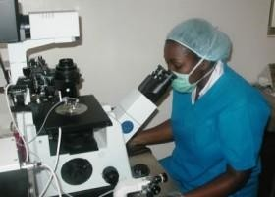
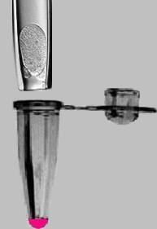



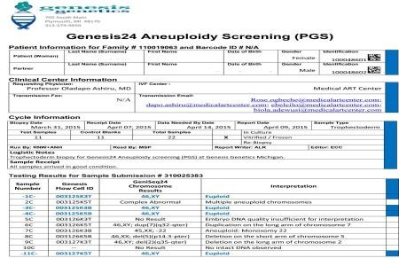


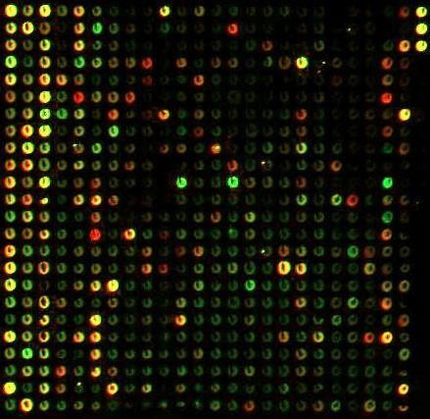

LABORATORY PROCESSESS INVOLVED
1.
2.
5.
3.
4.
27

Slide 41
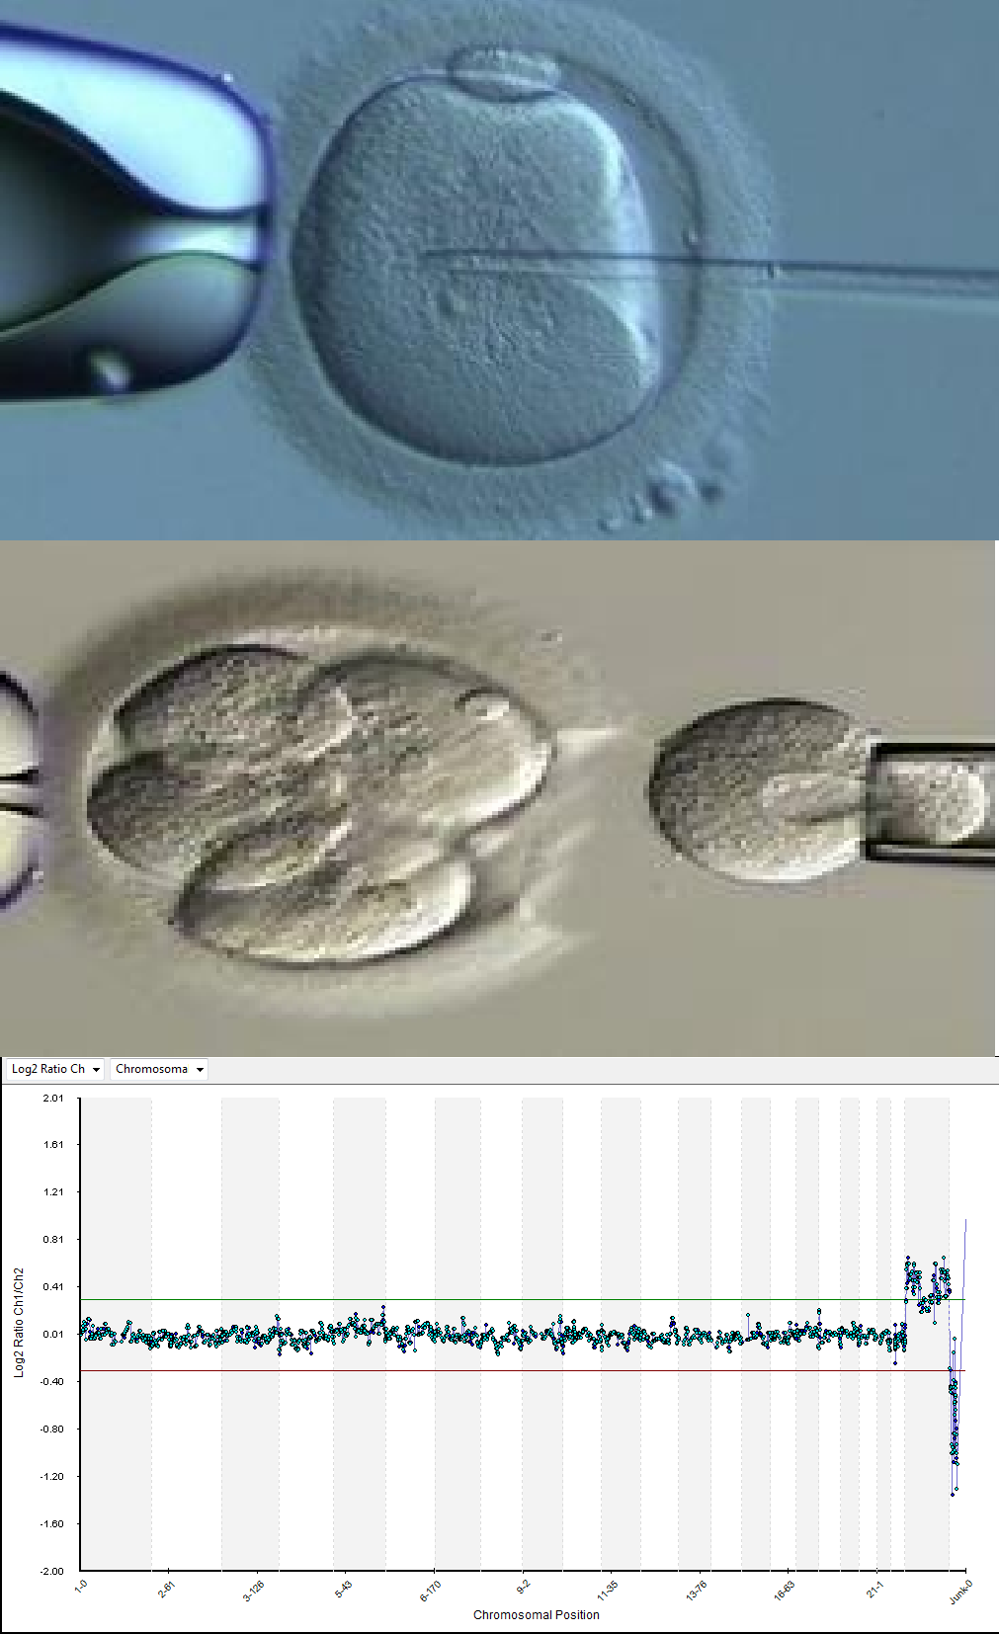
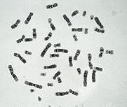

STEPS INVOLVED
◆ Embryos by IVF process
◆ Biopsy
Cell diagnosis - FISH / PCR /arrays

Slide 42
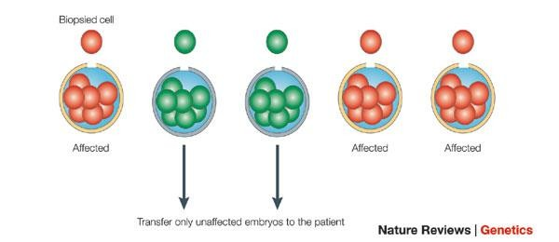

BIOPSY OBJECTIVE

Slide 43
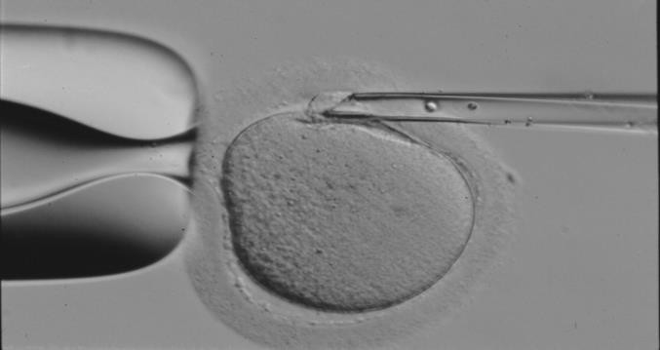
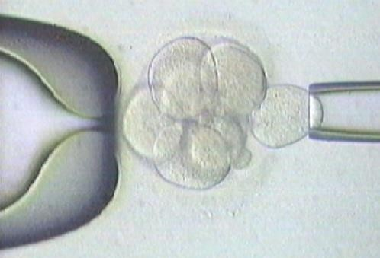


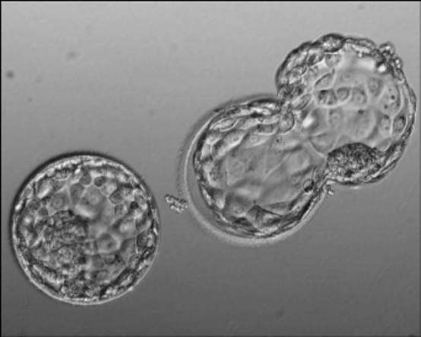
EMBRYO BIOPSY
Polar body
Cleavage stage
Blastocyst

Slide 44
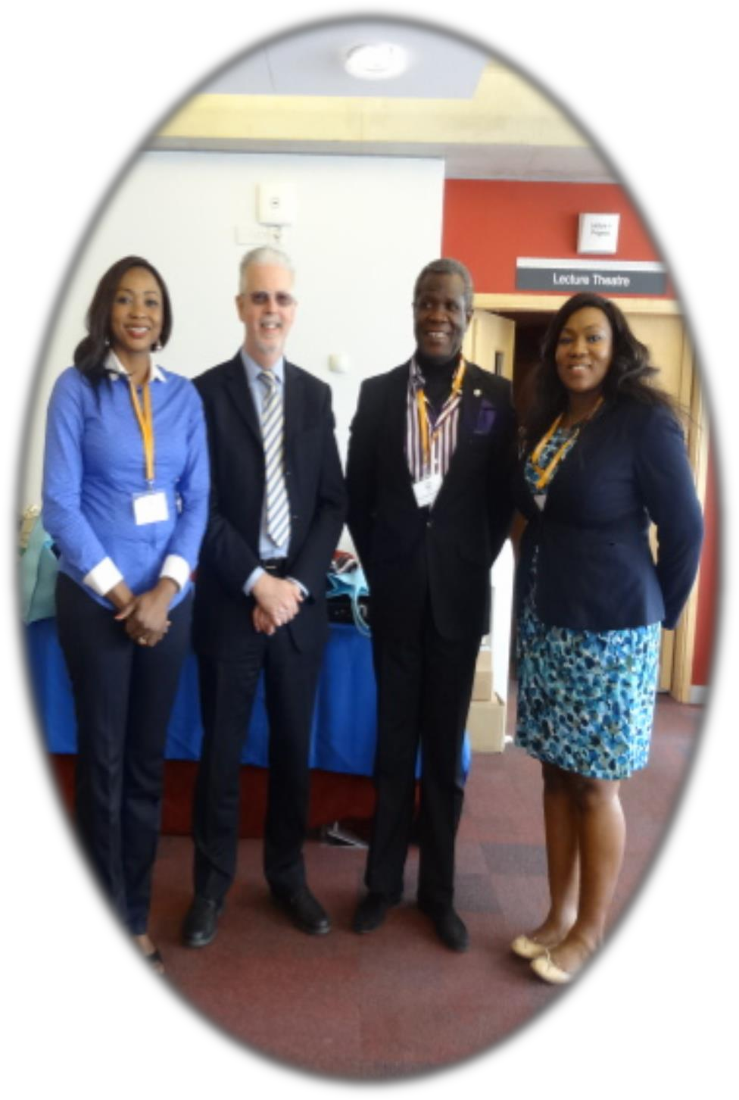
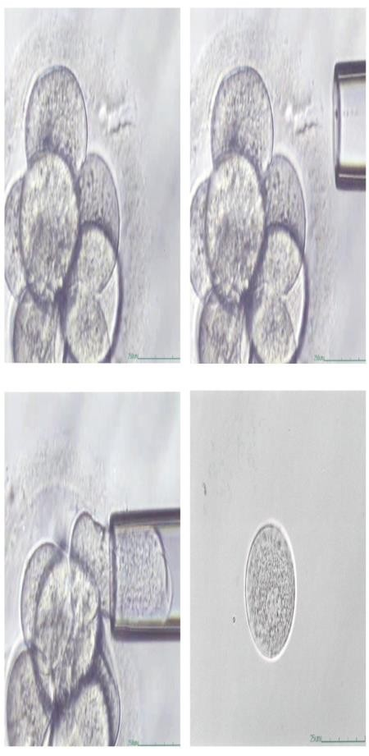
CLEAVAGE STAGE
1st Report – Alan Handyside
et al.,1989
◆ Zona drilling
Acid Tyrodes solution
Mechanical
Laser
◆ Blastomere removal
Displacement
Extrusion
Aspiration
31

Slide 45
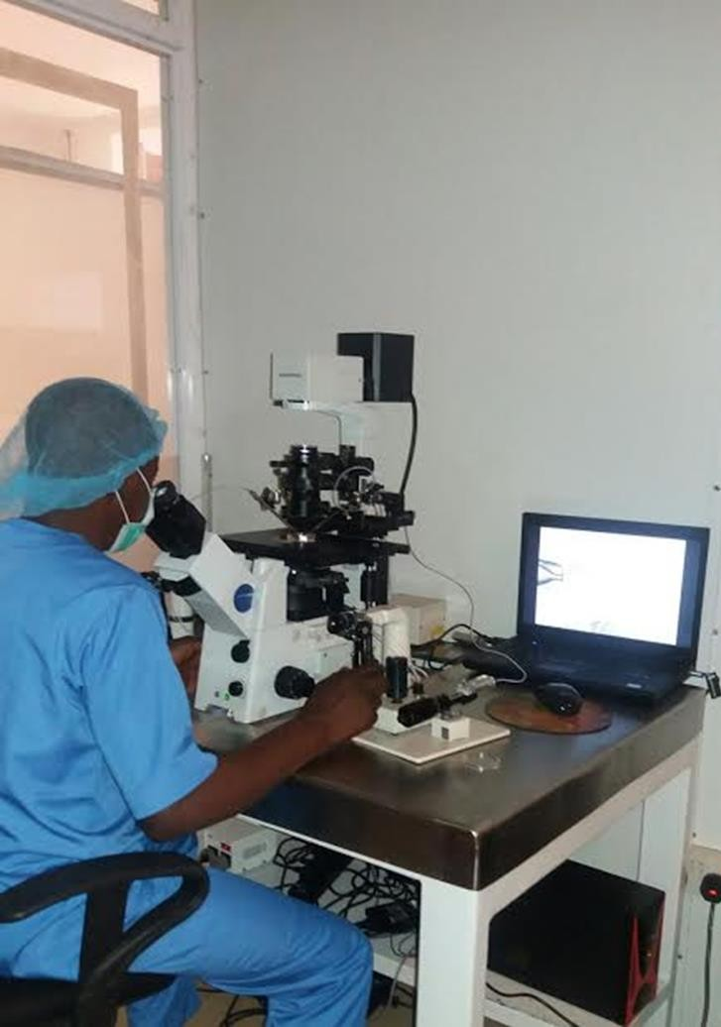
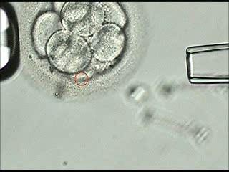
BLASTOMERE BIOPSY
32

Slide 46
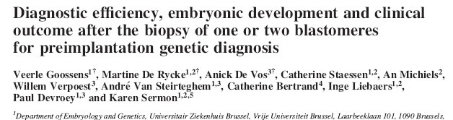
◆ Goossens et al. (2008), Belgium
◆ Prospective controlled trial
◆ 592 ICSI cycles
◆ Removal of 2 cells reduced blastocyst formation.
◆ Similar delivery and live birth per cycle started.
◆ PCR diagnosis -
◆ 1 cell reduced diagnostic efficiency
◆ 88.6% vs 96.4% (P<0.008)
◆ FISH cases
◆ Efficiency 98.2% vs 97.5% (NS)

Slide 47
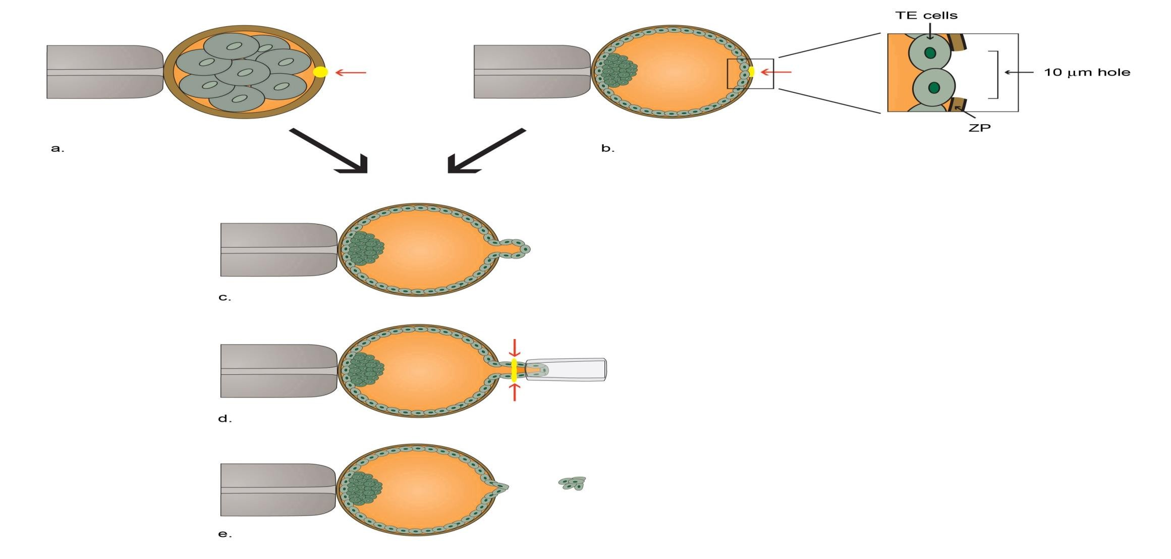
BLASTOCYST BIOPSY

Slide 48
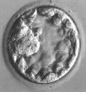
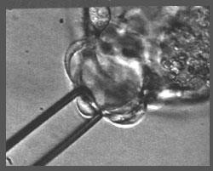
BLASTOCYST BIOPSY
◆ Zona drilling Day 3/4/5.
◆ Biopsy day 5/6.
◆ Differentiation of cell lines occurred.
Inner Cell Mass (ICM)
Trophectoderm (TE)
◆ TE herniating through the hole.
◆ ~5 cells excised.
Glass needle
Laser

Slide 49
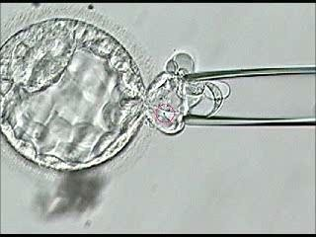

TROPHECTODERM BIOPSY
37

Slide 50
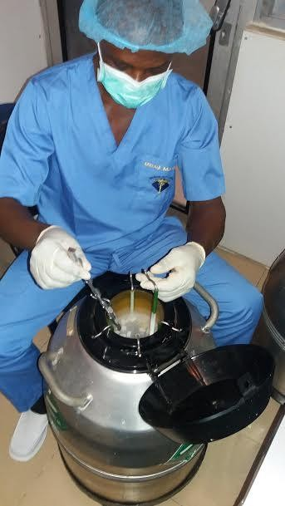
FREEZING OF EMBRYOS
38

Slide 51
BLASTOCYST BIOPSY
Advantages
◆ Larger number of cells can be taken
◆ Smaller proportion of embryonic
mass taken
◆ Not taking cells destined to contribute to the foetus
◆ Low levels of mosaicism
Disadvantages
◆ Short time for diagnosis
Good vitrification system
◆ <50% Blastocyst formation
Fewer embryos to test
Increased cycle cancellation
◆ Ethical acceptance

Slide 52






STAGES OF MOLECULAR ANALYSIS
◆ Tubing of cells
◆ Lysis of cells
Proteinase K digestion / Alkaline lysis
◆ Amplification
Polymerase Chain Reaction (PCR)
Whole Genome Amplification (WGA)
◆ Diagnosis
Fragment analysis
Minisequencing
Array

Slide 53
Methods of Genetic Analysis: PGD single
gene disorder
Whole genome amplification
Polymerase chain reaction (PCR)
Direct detection of specific mutation
Genotyping of linked polymorphic markers to ensure:
Bi-parental inheritance
Infer the inheritance of normal copy of the gene (Allele)

Slide 54
Methods of Genetic Analysis: Structural
chromosomal abnormality
◆ Fluorescent in situ hybridization (FISH)
◆ PCR-based testing
Whole genome amplification
Genotyping of linked polymorphic markers

Slide 55
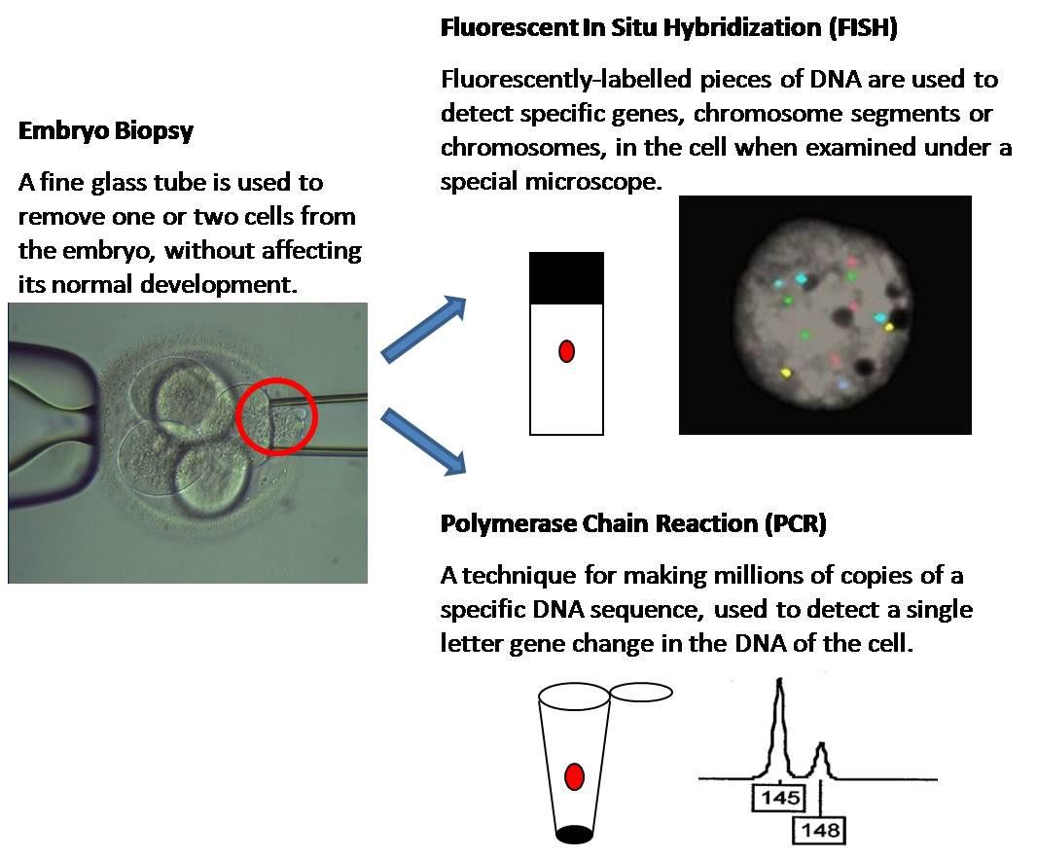
METHODS

Slide 56








DIAGNOSIS
◆ Polymerase chain reaction (PCR)
◆ Analyse specific mutation
◆ Single-gene disorders
◆ PGS
◆ Fluorescent in situ Hybridisation (FISH)
◆ Analyse chromosomes
◆ Sexing for X-Linked disorders
◆ Chromosomal abnormalities
◆ PGS
◆ Arrays (‘gold standard’)
◆ Analyse chromosome imbalances & /or
mutations by linkage CGH / SNP
◆ Chromosome abnormalities
◆ PGS
◆ Single gene disorders

Slide 57









COMPARATIVE GENOME HYBRIDISATION
Biopsied cell(s)
Amplify DNA
&
Control DNA
Biopsied cell DNA
Combine labelled DNA

Slide 58

ARRAY COMPARATIVE GENOMIC HYBRIDIZATION (aCGH)
◆ aCGH remains the ‘gold standard’ for PGS with the greatest clinical experience to date.
◆ RCTs show great promise for PGS.
◆ Numerous RCTs are ongoing.
◆ Next generation sequencing (NGS) has demonstrated accuracy of aCGH.
◆ aCGH is relatively easy to set up but…
◆ Use of a reference laboratory recommended as a first step
46

Slide 59
PRECAUTIONS!
Contamination
  ICSI for PCR/A-CGH (Sperm Contamination)
  Total Cumulus cell removal D0-3 (Maternal contamination)
Witnessing
  Biopsy procedure→ Numbering of dishes pre/post biopsy
  Tubing/ spreading procedure→Numbering of tubes/ slides
  Single embryo per dish
  Communication!
DNA Free
  UV irradiate all consumables/ instruments for tubing (30mins)
  DNA Haplotyping of all staff involved
  Sterile- gowns, gloves, hats, masks

Slide 60

RECENT STUDIES
48

Slide 61

RCTS USING NEW TECHNOLOGY

Slide 62

Young, good prognosis patients (< 35)
First time IVF patients
Normal karyotype
Elective single embryo transfer
In MART e-DET since late 2015

Slide 63






SUMMARY OF REASONS FOR PGD/PGS (N=75)-2018
45%
43%
40%
35%
30%
32%
23%
25%
20%
15%
10%
5%
0%
CA
FB
SC

Slide 64

SUMMARY FOR CHROMOSOME ANEUPLOIDY (N= 32)
SUMMARY OF EMBRYO BIOPSED FOR CHROMOSOMES ANEUPLIODY (N=300)
◆ 59% of embryos biopsied were abnormal
◆ 15% No result rate
60%
50%
40%
30%
59%
26%
20%
15%
10%
0%
Normal
Abnormal
No Result

Slide 65

SICKLE CELL DIAGNOSIS (PGD) N = 17 DAY 3
SUMMARY OF EMBRYO BIOPSED FOR SICKLE CELL DIAGNOSIS (N= 133)
◆ 41% of biopsied embryos were homozygous and heterozygous normal
◆ 34% of embryos undiagnosed
◆ 25% Abnormal
50%
41%
40%
34%
30%
25%
20%
10%
0%
RESULT OF…
Normal
Abnormal
No Result

Slide 66
CLEAVAGE VS TROPHECTODERM BIOPSY
 | DAY 3 NO. | DAY 5 NO. | PREG % D3 | PREG D5/6 | D3 NO RESULT % | D5/6 RESULT %
CHR. ANEUPLOIDY AV. AGE= 40.1 | 32 | 15* | 30% | 6(42.9%) | 15% | 6.7%
SICKLE ANAEMIA AV. AGE= 33.8 | 17 | 8 | 9% | 4(50%) | 34% | 9.1%
*D5 CA group only 14 patients had embryo transfer-Sept 2018
54

Slide 67

COMPARISON OF PREGNANCY RATES: CLEAVAGE VS TROPHECTODERM BIOPSIES
32%
55

Slide 68

COMPARISON OF NO RESULT RATES: CLEAVAGE VS TROPHECTODERM BIOPSIES
56

Slide 69
FUTURE OF PGD
PGD
New technology to allow diagnosis of more disorders
WGA
SNP arrays, array-CGH, sequencing
Blastocyst biopsy and vitrification
Improving Implantation Success
Improving External factors possibly affecting success

Slide 70


Slide 71



Slide 72




Slide 73


Slide 74

POSSIBLE ROLE FOR MAYR THERAPY AND DETOXIFICATION BEFORE PGD
◆ REMOVAL OF NUTRITIONAL TOXINS
◆ REMOVAL OF HEAVY METALS
◆ IMPROVEMENT OF MITOCHONDRIAL QUALITY
◆ TOTAL BODY DETOXIFICATION
◆ ANTIOXIDANT THERAPY
◆ ORTHOMOLECULAR SUPPLEMENTATION

Slide 75
SUMMARY
PGD has been used to successfully select embryos that are sickle cell free.
Currently, we have two ongoing pregnancies(twin and singleton) after PGD.
Availability of genetic counselors and trained geneticists to answer lab and patient questions.

Slide 76
SUMMARY
Partnership with world renowned centers allowing for data collection across centers with publications.
Reference center partnerships allow for faster access to current and new technologies for PGD and PGS.
64

Slide 77
CONCLUSION
COMMUNICATION
Excellent IVF Platform
Excellent Diagnostics Laboratory
Integration of Services
Rigorous Quality Control/Quality Assurance
Commitment to Follow-up
65

Slide 78

BEETHOVEN
“I RECOGNIZE NO SUPERIORITY IN MANKIND OTHER THAN GOODNESS.”

Slide 79

OUR TEAM
…….Teaming up for a successful sickle cell- free family!
67

Slide 80
THANK YOU FOR LISTENING
68

Slide 81

www.medicalartcenter.com info@medicalartcenter.com dapo.ashiru@medicalartcenter.com
+(234)803-334-7231

